Slide 1

Generics
Lecturer
Rokas Slaboševičius
Data

Slide 2
Generics Repeat
Generics
What are generics?
How are generics developed?
How are generics used?

Slide 3
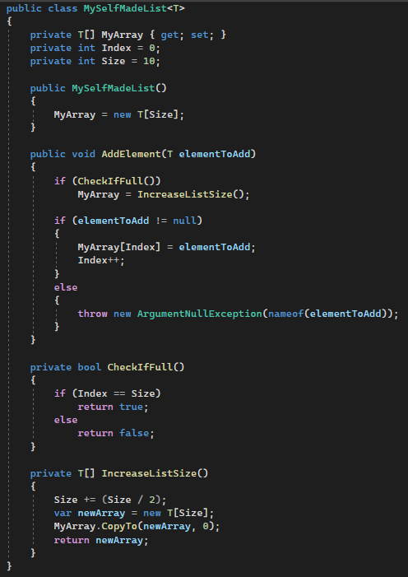
Generics Repeat
Generics
Remembering the Generic class

Slide 4

Generics
Task 1
Generics parameters can be used in more than one e.g. Method<T1,T2>
Create a class that accepts two generic type parameters.
The class will have two variables that will correspond to those generic parameters.
Will have four functions, two of which will be printed in T1 and T2 properties
The other two functions will allow you to change the value of T1 and T2 properties.

Slide 5
Generics
Task 2
Create class FourSideGeometricFigure
Properties:
Name
Base
Height
Functions:
GetArea()
Also override the ToString() function to return the described object.
Then create a method Show in the Generator<T> class that prints the value returned by the passed ToString() object.

Slide 6
Generics
Task 3
Create a Type class that accepts two Type T variables
It will have a function GetType with parameter T input, which will print the data type of the input variable.

Slide 7
Generics
Task 4
Create a generic class for sports game leagues.
The class must allow you to add a new team to the list of its league.
The class must have a method to print all the commands.
The class must only allow teams from the same sport to be added, if a team from a different sport is added, the program must discard error.

